Slide 1

South Region
Gas Regional Investment Plans
SGRI – 19th June 2013

Slide 2
GRIP South
Index
  Perimeter / objectives
  Methodology / Content
  Planning
2

Slide 3
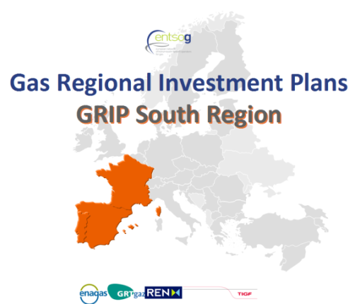
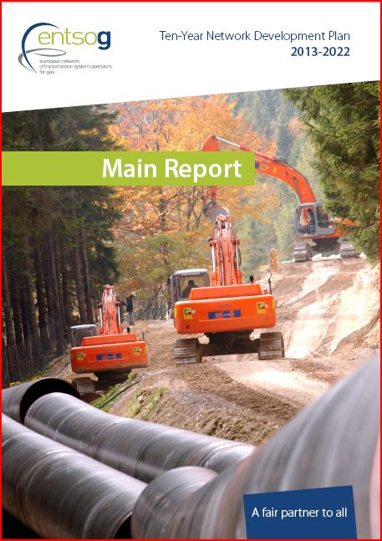
Perimeter /Objectives
3 Countries (FR, SP, PT) and 4 TSOs
Main drivers/objectives
Complementing EU-TYNDP
Consistent with National Plans
Taking into account feedbacks received on GRIPs:
  → More GRIPs harmonization , more guidance from ENTSOG
  Improve stakeholders communication /consultation
  More detailed/focussed approach on needs (assessments, analysis...) and remedies (projects) /TYNDP
  updated information / TYNDP
EU energy policy, “Trans-European energy infrastructure” (12/03/13)
“The strategic concept of the North-South Corridor in Western Europe, that is to better interconnect the Mediterranean area and thus supplies from Africa and the Northern supply Corridor with supplies from Norway and Russia.” (EC, EIP for 2020)

Slide 4
Methodology
  GRIPs harmonization and ENTSOG guidance:
    Common starting point: TYNDP 2013
    Dedicated workshops organized with ENTSOG (ongoing)
      To address : homogeneous content and regional specificities, common workshops for external communication, etc.
  Consultation of stakeholders
    SGRI meetings
    External ENTSOG Workshop(s) dedicated on GRIPs (to confirm)
    Consultation on the draft document (to clarify)
4

Slide 5
Methodology
  Network assessments / remedies
    More detailed analysis of the needs / TYNDP
    Additional network assessments are planned
      Examples (to confirm) : additional modelling, Hub price spreads analysis, interconnections utilization rates, market consultations, regulations compliance, etc.
    Remedies : more precise assessment of the projects being remedies of needs identified in the network assessment
5

Slide 6
Content
  Introduction
  Demand: analysis of the demand in the South region
  Supply: analysis of the assets and the needs of the Region
  Projects: analysis of the projects in the South Region
  Network assessments:
    In-depth analysis of the TYNDP assessments
    Other assessments /analysis
  Remedies (separated or merged with the Network assessment chapter):
    In-depth analysis of projects answering to needs identified in the chapter “Network assessment”
  Conclusion
  Appendices: detailed data
6

Slide 7
Planning
  TSOs meetings : from October 2012 ...
  ENTSOG TYNDP publication : 21st February 2013
  Writing of the new GRIP : from February 2013 ...
  Stakeholders communication / consultation:
    GRI South meeting(s) : IG meetings, SG meetings
    ENTSOG meeting(s) : Workshop in September 2013, others? (to confirm)
    Consultation phase on TSOs and ENTSOG websites (to confirm/clarify)
  Publication : Q4 2013
7

Slide 8
Thank you for your attention

